Slide 1
INFODESK
(Based on the concept of Clinic Management System)
InfoDesk is developed to support the clinic daily operations before this is done manually. This project will involve all the major clinic operations starting from patient registration till providing the prescription of the medicine . The important thing is it will become easier for the data record and retrieval. The system will include database that will record all the data. This project will automate the workflow that happens in the clinic.

Slide 2
High Level Functionalities
New Users Signup as Doctors , Secretary and Pharmacist.
Login is authorized to the registered users only along with their roles that are specified to them.
Role of a Secretary is to fill the details of patients and booking the appointments with the doctor but a secretary can only edit the details, not delete it. The details are visible to the doctor.
Role of a Doctor is to see the patient and provide them with suitable prescription/medicine according to their symptoms but Doctor cannot edit the details of the patient. Prescription/medicine are visible to Pharmacist.
Role of a Pharmacist is to provide the patient with their respective prescription/medicine.

Slide 3
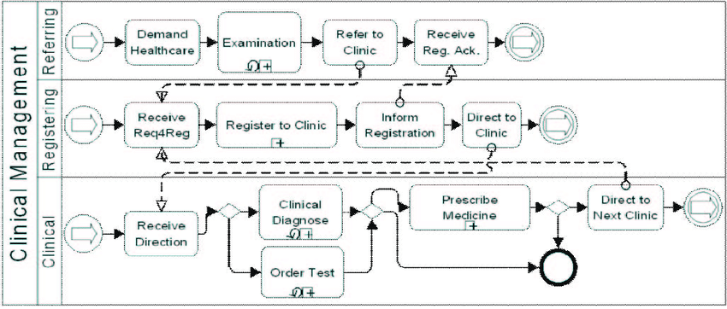
Project Architecture Diagram

Slide 4
Technologies Used
Microsoft Visual Studio 2019.
Microsoft SQL Server Express.
Microsoft SQL Server Management Studio (SSMS).

Slide 5
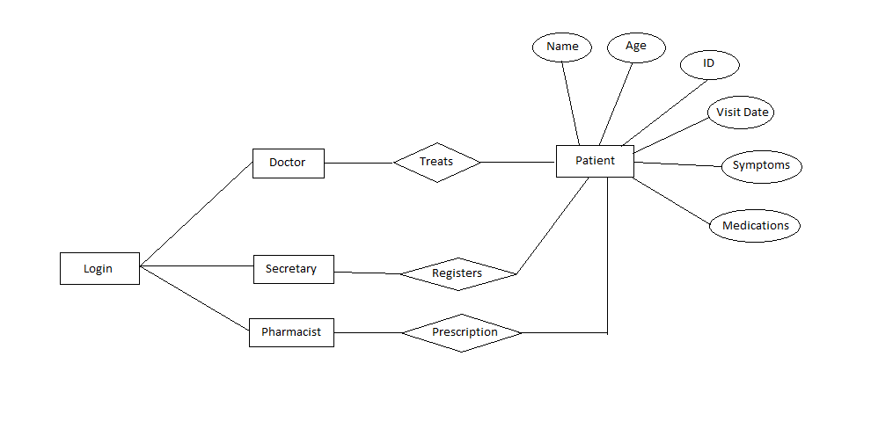
E-R Diagram

Slide 6
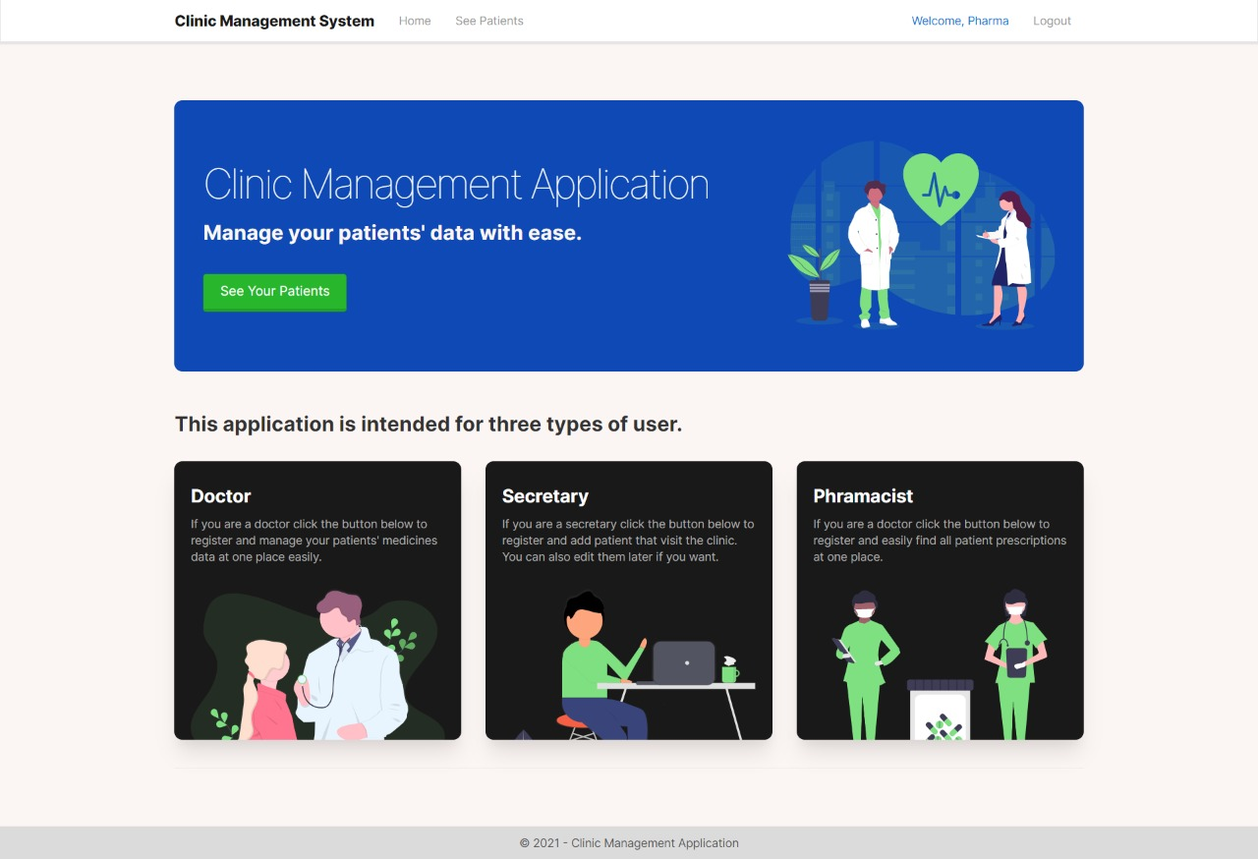
Screenshots

Slide 7
